Slide 1




Slide 14
Compose camp
2022
Display lists & use Material design

Slide 15
Compose camp
2022
Display lists & use Material design

Slide 16
Compose camp
2022
Display lists & use Material design

Slide 17

Compose camp
2022
Presented by
Display lists & use Material design

Slide 18
Compose camp
2022
Presented by
Display lists & use Material design

Slide 19

In this course, you’ll learn
Presented by

Slide 20

In this course, you’ll learn
Presented by

Slide 21
In this course, you’ll learn
Presented by

Slide 22
In this course, you’ll learn

Slide 23

In this course, you’ll learn
And also learn to build your very own working android
application from scratch.

Slide 25


Welcome to
Day 3
Kotlin
Fundamentals
Learn to create scrollable lists
& implement Material Design
Great
Digital
Rewards

Slide 26
Welcome to
Day 3
Kotlin
Fundamentals
Add UI components & learn to implement
user interactions
Great
Digital
Rewards

Slide 27
Welcome to
Day 3
Kotlin
Fundamentals
Learn to create scrollable lists
& implement Material Design
Great
Digital
Rewards

Slide 28


Welcome to
Day 3
Kotlin
Fundamentals
Learn to create scrollable lists
& implement Material Design
Great
Digital
Rewards

Slide 29
Unit 03
Let’s learn
The Kotlin
Fundamentals

Slide 30
Unit 03
Let’s learn
The Kotlin
Fundamentals

Slide 31
Unit 03
Let’s learn
The Kotlin
Fundamentals

Slide 32
More Kotlin fundamentals
Generics, objects, and extensions
Over the decades, programmers devised several programming language features to help you write better code. The Kotlin language is no exception, and there are a number of features intended to help developers write more expressive code.
Generics
Different kinds of classes (enum classes and data classes)
Singleton and companion objects
Extension properties and functions
Scope functions
Unit 03
Learn to
make scrollable lists

Slide 33
Make a reusable class with generics
Generics are the powerful features that allow us to define classes, methods and properties which are accessible using different data types while keeping a check of the compile-time type safety.

Slide 34
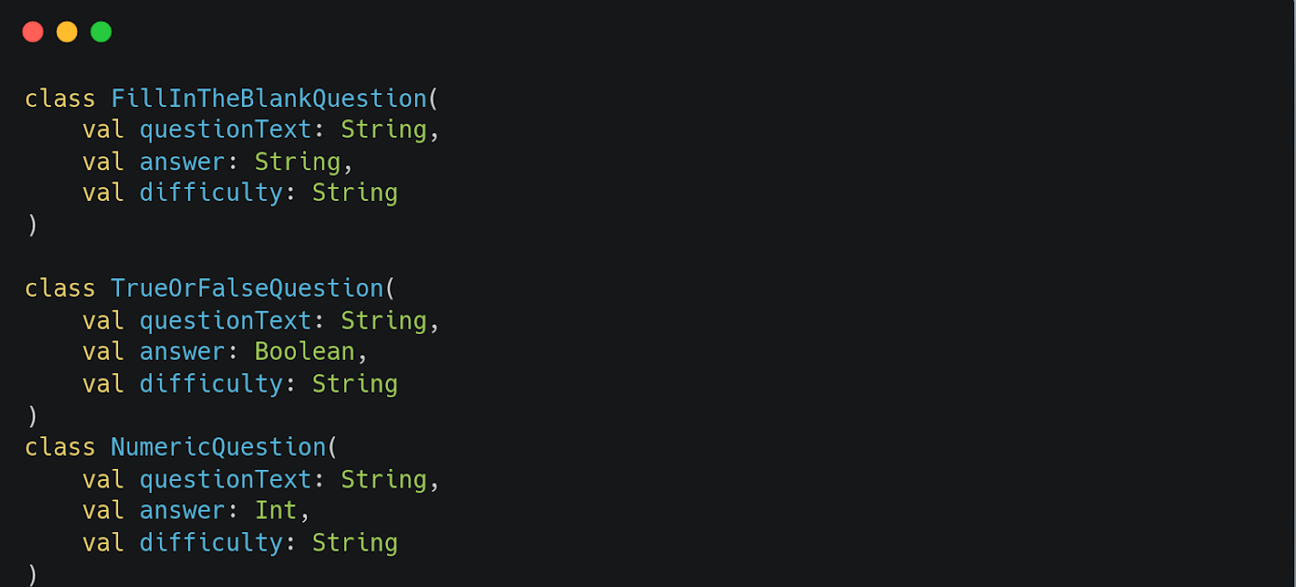
When you want a property to have differing data types, subclassing is not the answer. Instead, Kotlin provides something called generic types that allow you to have a single property that can have differing data types, depending on the specific use case
For a use case,
let’s consider different types of questions.

Slide 35
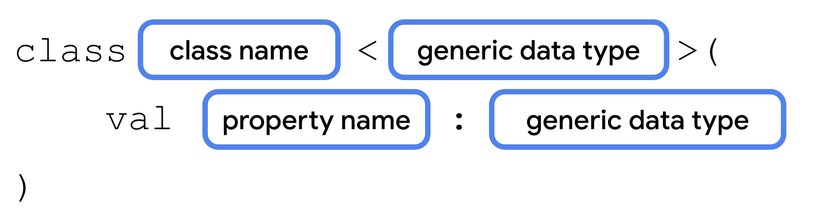
What is a generic data type?
Generic types, or generics for short, allow a data type, such as a class, to specify an unknown placeholder data type that can be used with its properties and methods.
The syntax for defining a generic type for a class is shown below:

Slide 36

How would your class ultimately know which data type to use? The data type that the generic type uses is passed as a parameter in angle brackets when you instantiate the class.
Note: The generic types passed in when instantiating a class are also called "parameters", although they're part of a separate parameter list than the property values placed inside the parentheses

Slide 37
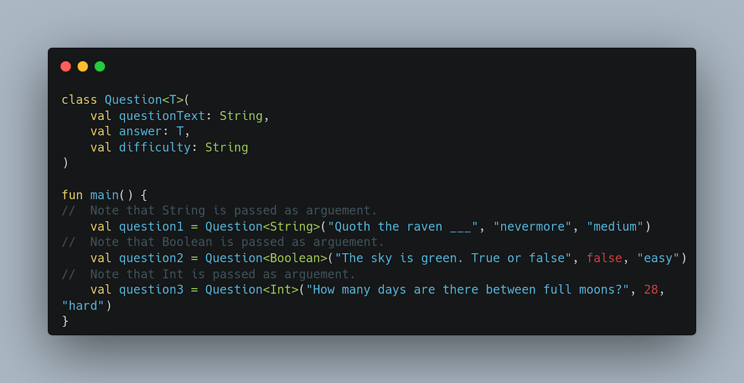

Slide 38
Use an enum class
An enum class is used to create types with a limited set of possible values.
In the real world, for example, the four cardinal directions—north, south, east, and west—could be represented by an enum class. There's no need, and the code shouldn't allow, for the use of any additional directions.

Slide 39
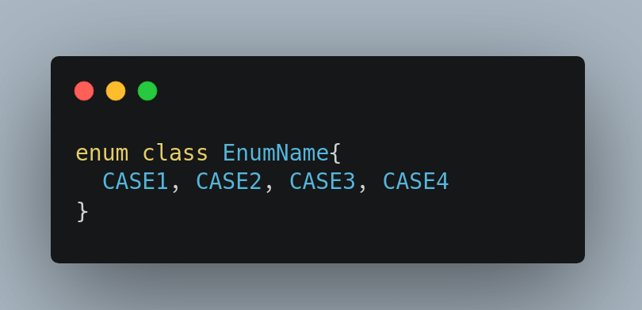
The syntax for an enum class is shown below.

Slide 40
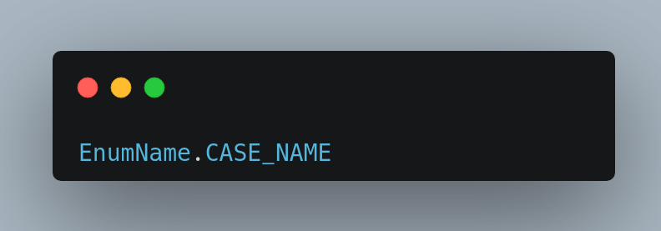
Each possible value of an enum is called an enum constant. Enum constants are placed inside the constructor, separated by a comma. The convention is to capitalize every letter in the constant name. You refer to enum constants using the dot operator.

Slide 41
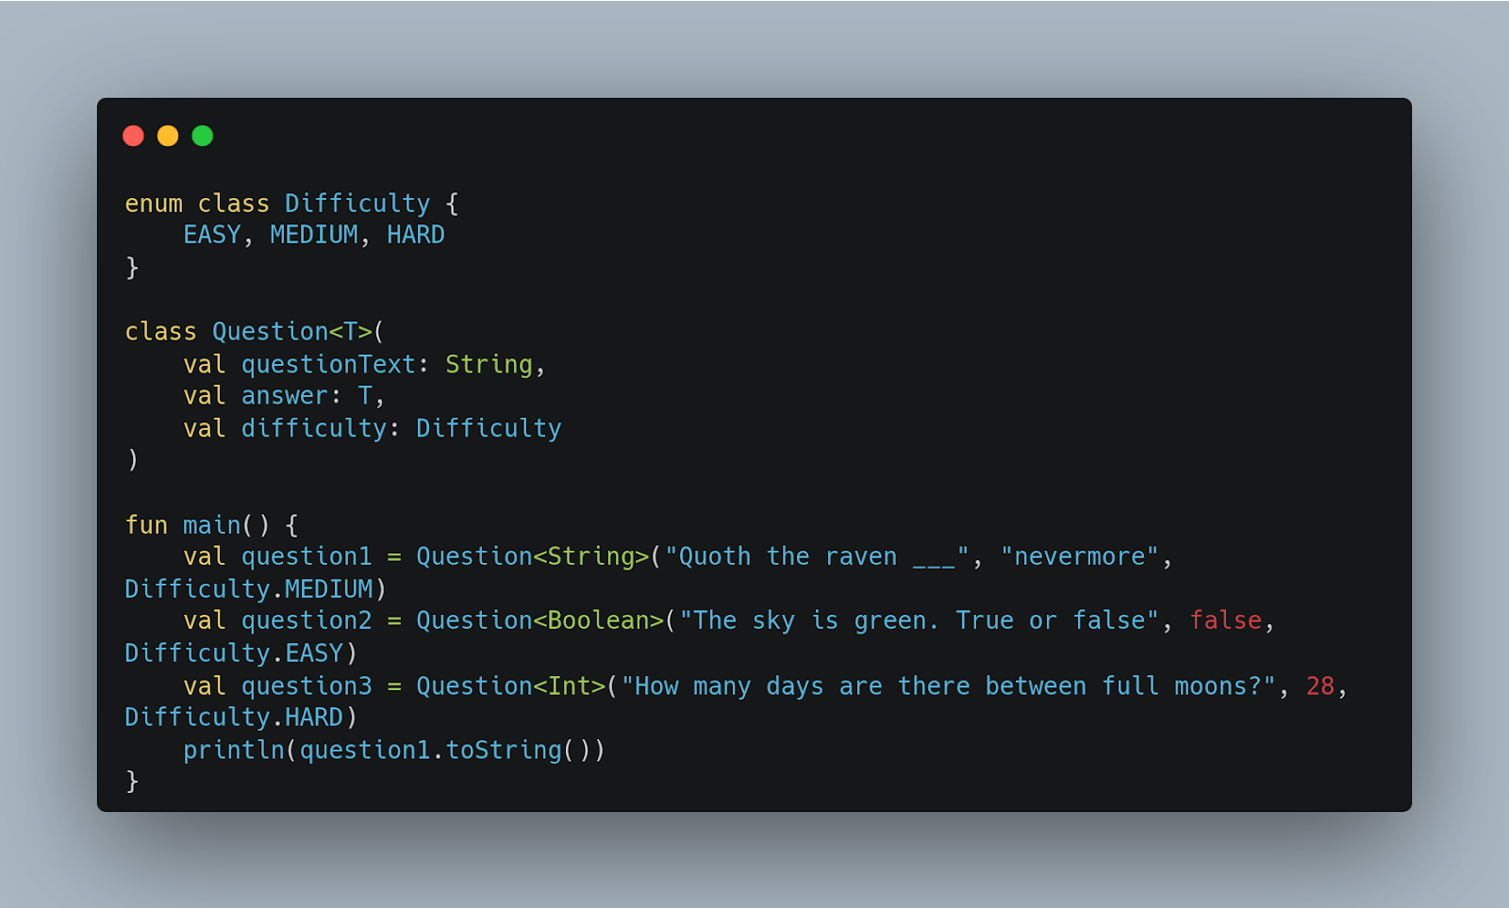

Slide 42
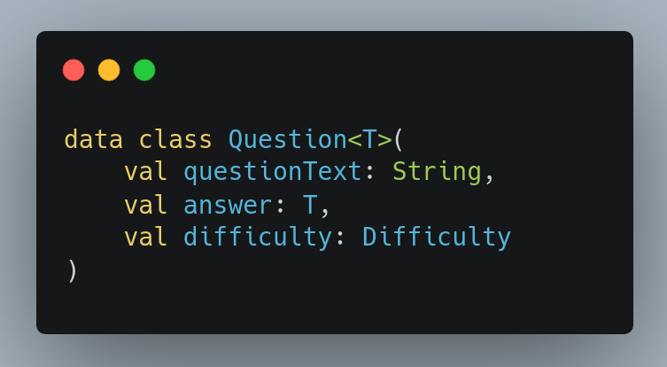
It is not unusual to create classes whose main purpose is to hold data. In such classes, some standard functionality and some utility functions are often mechanically derivable from the data. In Kotlin, these are called data classes and are marked with “data”.
Use a data class

Slide 43
When a class is defined as a data class, the following methods are implemented.
equals()
hashcode()
toString()
componentN()
copy()

Slide 44
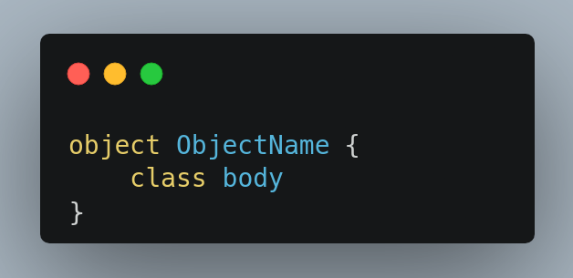
Use a singleton object
A singleton is a class that can only have a single instance. Kotlin provides a special construct, called an object, that can be used to make a singleton class. The syntax for an object is similar to that of a class. Simply use the object keyword instead of the class keyword. A singleton object can't have a constructor as you can't create instances directly. Instead, all the properties are defined within the curly braces and are given an initial value.

Slide 45
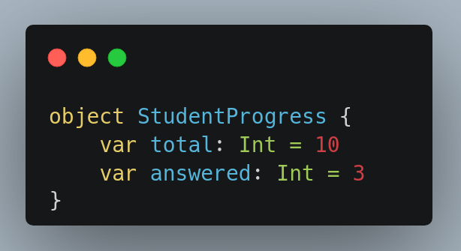
For example, we'll assume there are ten total questions, and that three of them are answered so far. Add two Int properties: total with a value of 10, and answered with a value of 0.

Slide 46
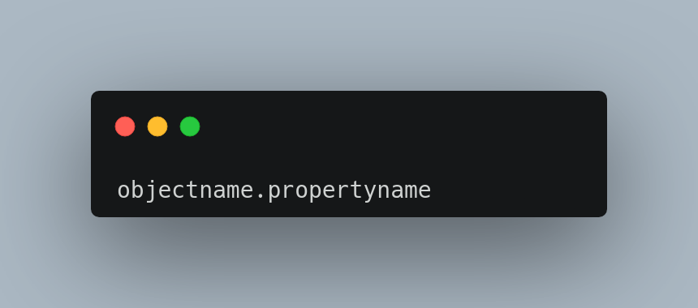
Access a singleton object
You access its properties by referring to the name of the object itself, followed by the dot operator (.), followed by the property name.

Slide 47
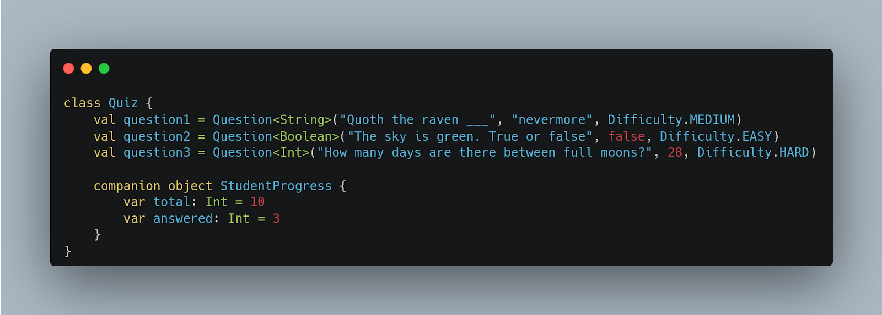
Declare objects as companion objects
You can define a singleton object inside another class using a companion object. A companion object allows you to access its properties and methods from inside the class, if the object's properties and methods belong to that class, allowing for more concise syntax.

Slide 48
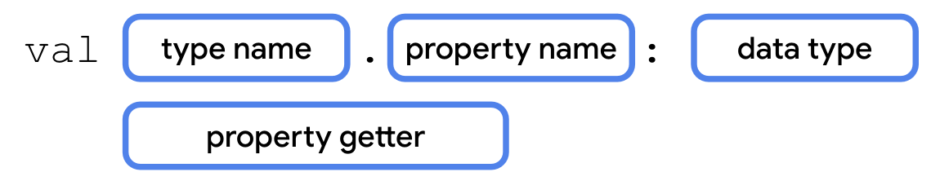
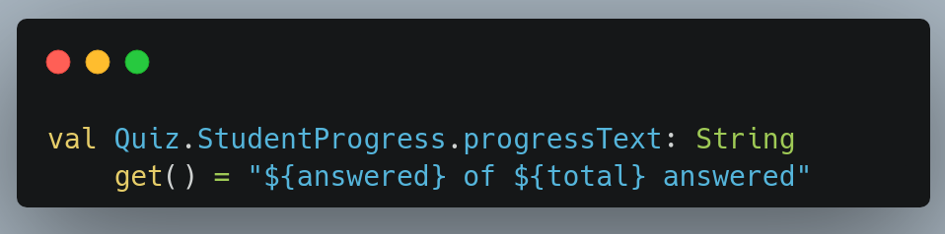
Extend classes with new properties and methods
What the Kotlin language does is give other developers the ability to extend existing data types, adding properties and methods that can be accessed with dot syntax, as if they were part of that data type. To define an extension property, add the type name and a dot operator (.) before the variable name.

Slide 49
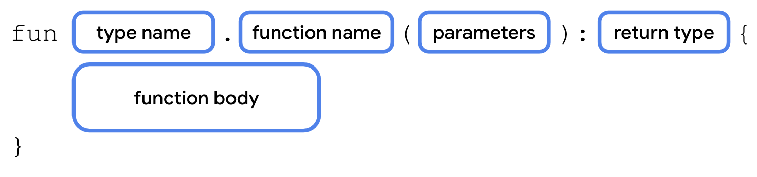
Add an extension function
To define an extension function, add the type name and a dot operator (.) before the function name.

Slide 50
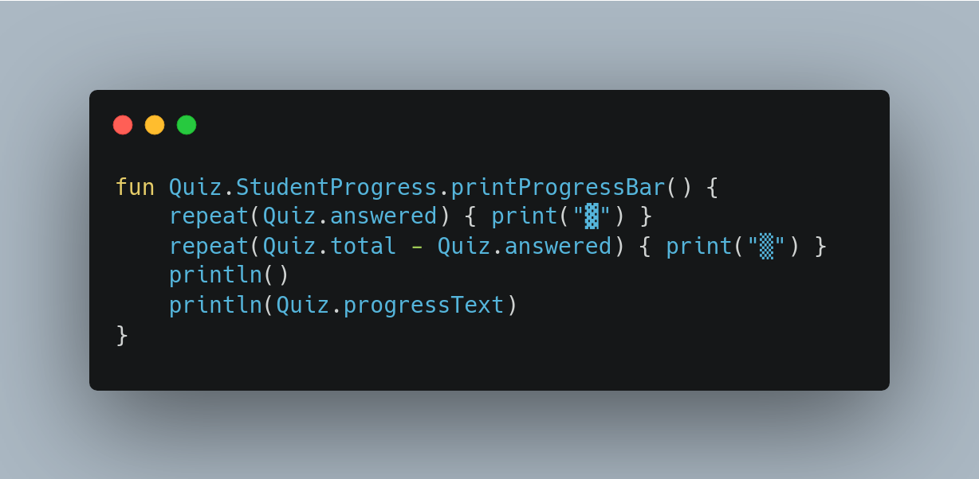
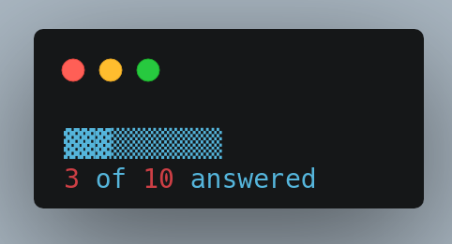

Slide 51
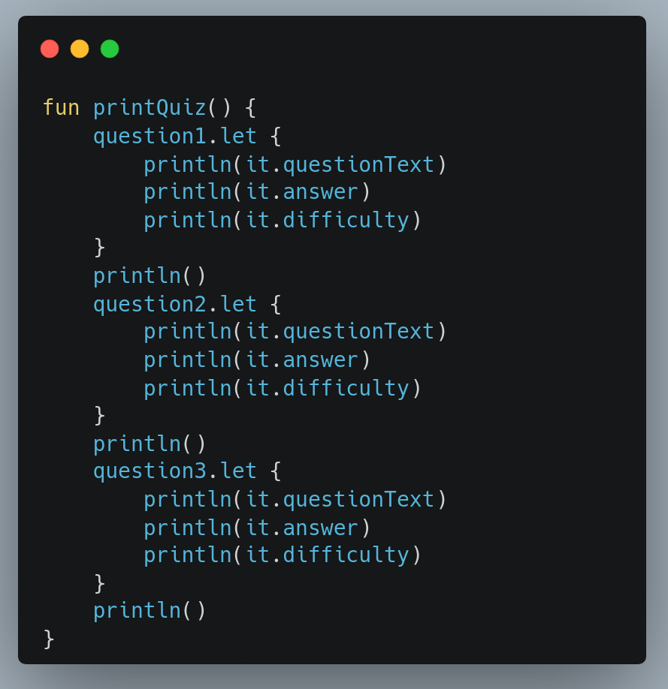
Replace long object names using let()
The let() function allows you to refer to an object in a lambda expression using the identifier “it”, instead of the object's actual name.

Slide 52
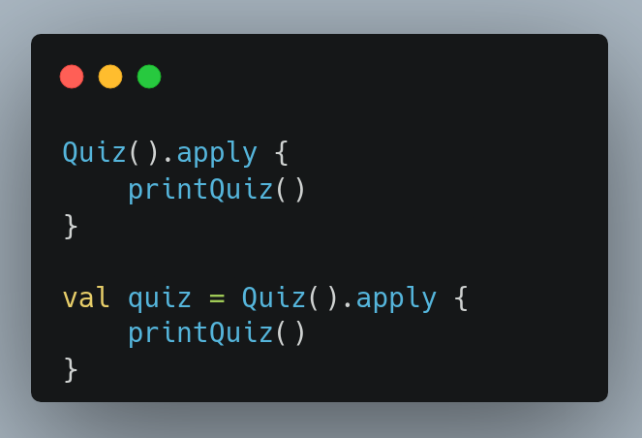
Call an object's methods without a variable using apply()
The apply() function is an extension function that can be called on an object using dot notation. The apply() function also returns a reference to that object so that it can be stored in a variable.

Slide 53
Use collections in Kotlin
Collection types (sometimes called data structures) let you store multiple values, typically of the same data type, in an organized way. A collection might be an ordered list, a grouping of unique values, or a mapping of values of one data type to values of another.

Slide 54
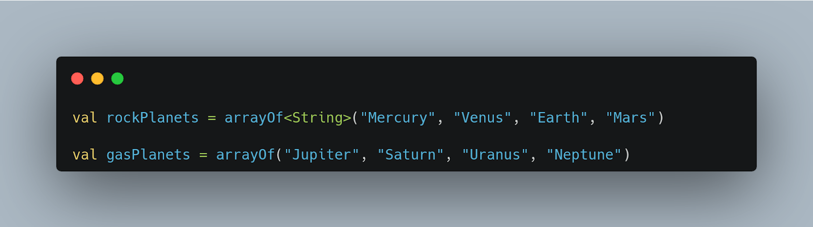
Arrays in Kotlin
An array is the simplest way to group an arbitrary number of values in your programs.

Slide 55
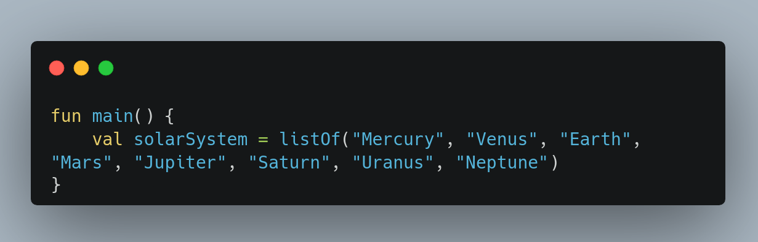
Lists in Kotlin
A list is an ordered, resizable collection, typically implemented as a resizable array. When the array is filled to capacity and you try to insert a new element, the array is copied to a new bigger array.

Slide 56
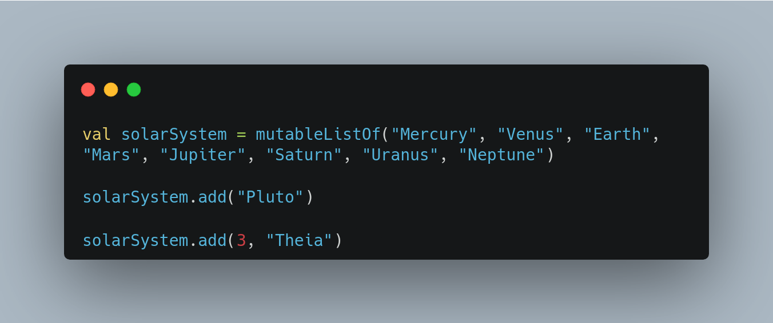
List and MutableList
List is an interface that defines properties and methods related to a read-only ordered collection of items.
MutableList extends the List interface by defining methods to modify a list, such as adding and removing elements.

Slide 57
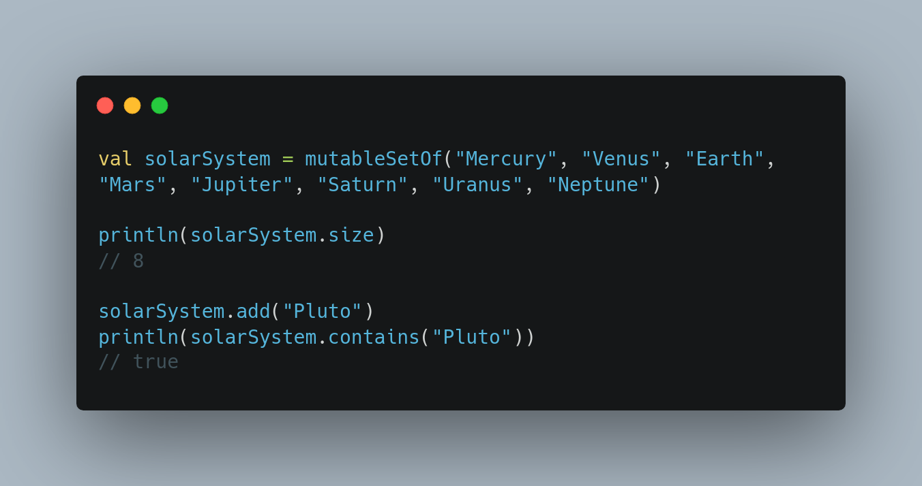
Sets in Kotlin
A set is a collection that does not have a specific order and doesn't allow duplicate values. Like List and MutableList, there's both a Set and a MutableSet. MutableSet implements Set, so any class implementing MutableSet needs to implement both.

Slide 58
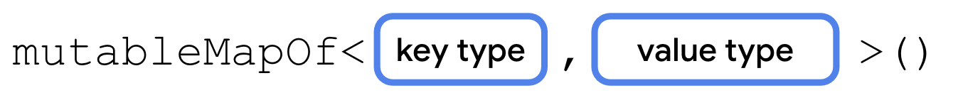
Map collection in Kotlin
A Map is a collection consisting of keys and values. It's called a map because unique keys are mapped to other values. A key and its accompanying value are often called a key-value pair.
Maps can be declared using the mapOf() or mutableMapOf() function. Maps require two generic types separated by a comma—one for the keys and another for the values.

Slide 59
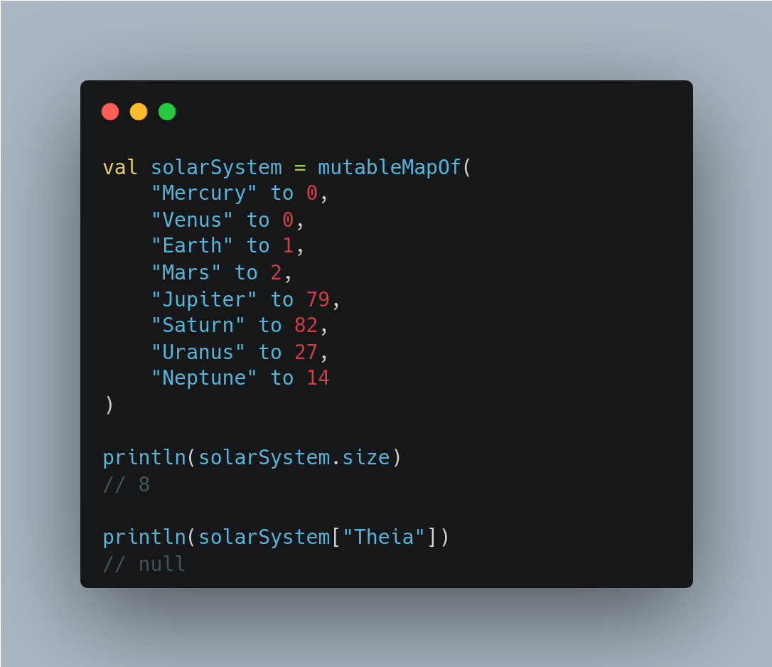

Slide 60
Higher-order functions with collections
Higher-order functions are especially relevant to collections as they help you perform common tasks, like sorting or filtering, with less code.

Slide 61
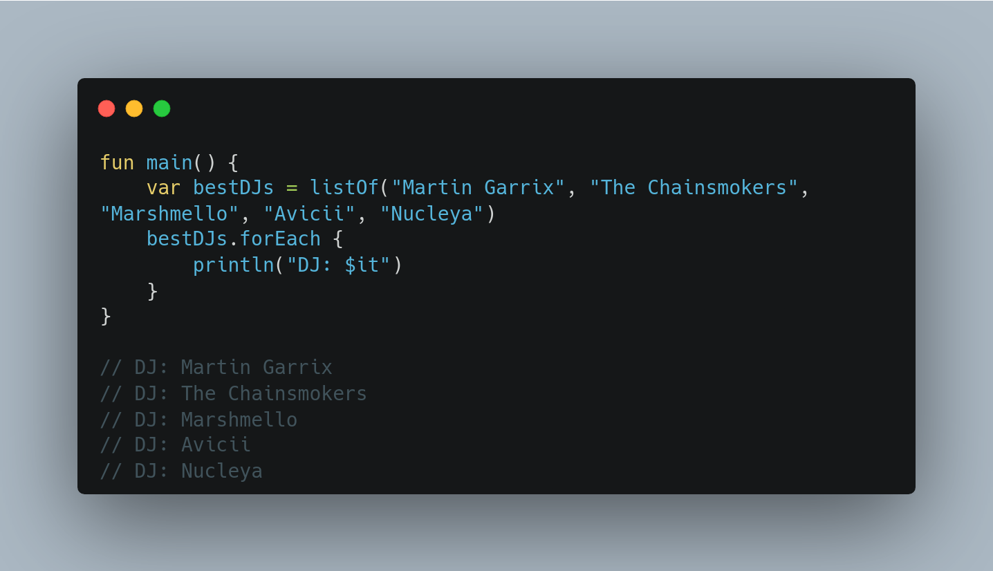
Loop over a list with forEach()
The forEach() function executes the function passed as a parameter once for each item in the collection. This works similarly to the repeat() function, or a for loop.

Slide 62
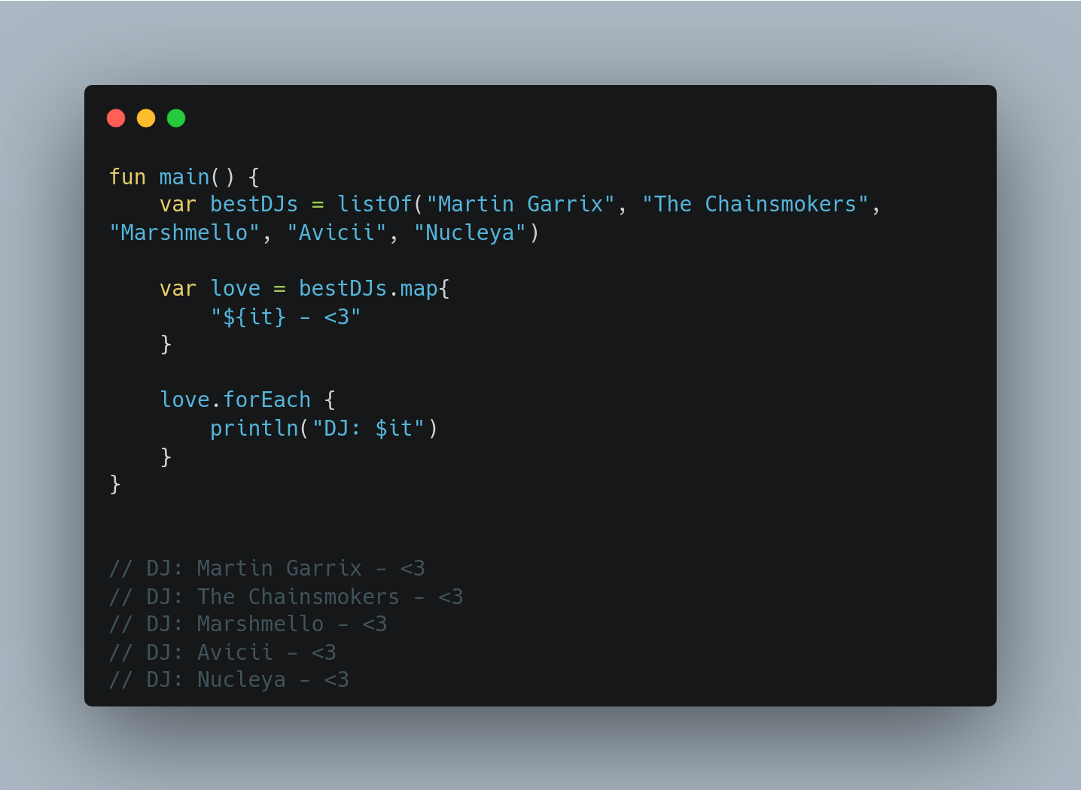
map()
The map() function lets you transform a collection into a new collection with the same number of elements.

Slide 63
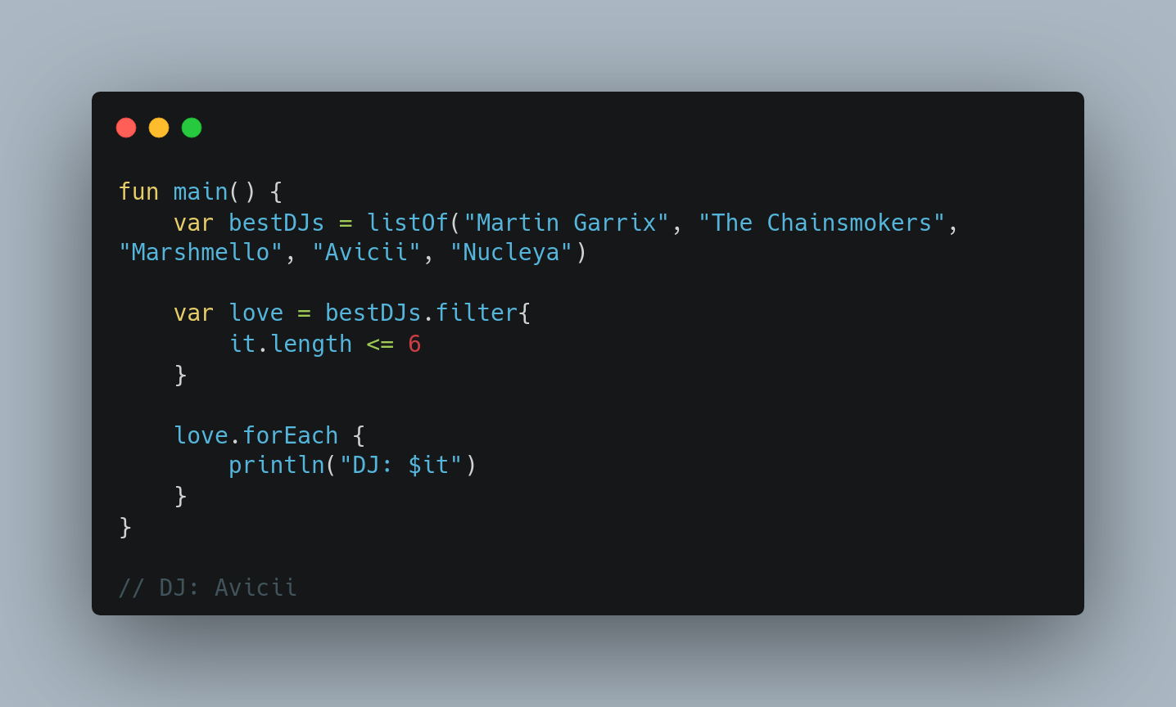
filter()
The filter() function lets you create a subset of a collection.

Slide 64
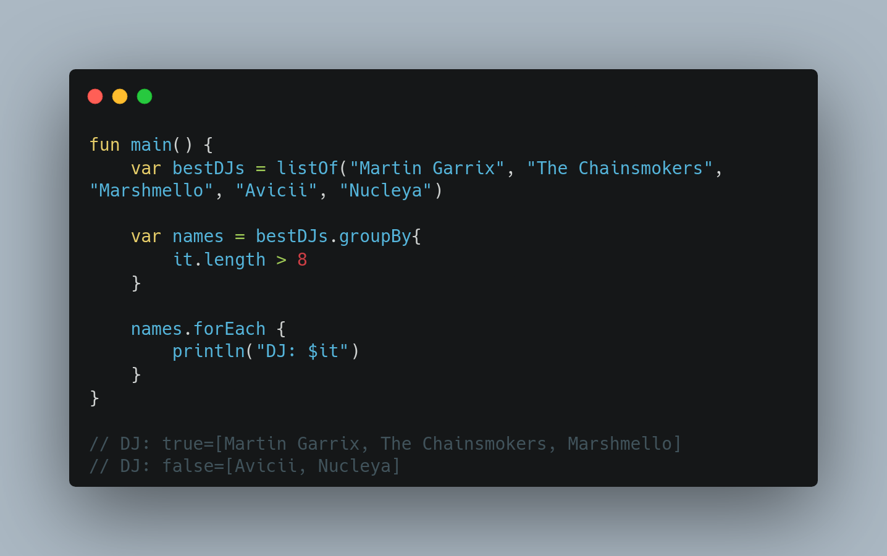
groupBy()
The groupBy() function can be used to turn a list into a map, based on a function. Each unique return value of the function becomes a key in the resulting map. The values for each key are all the items in the collection that produced that unique return value.

Slide 65
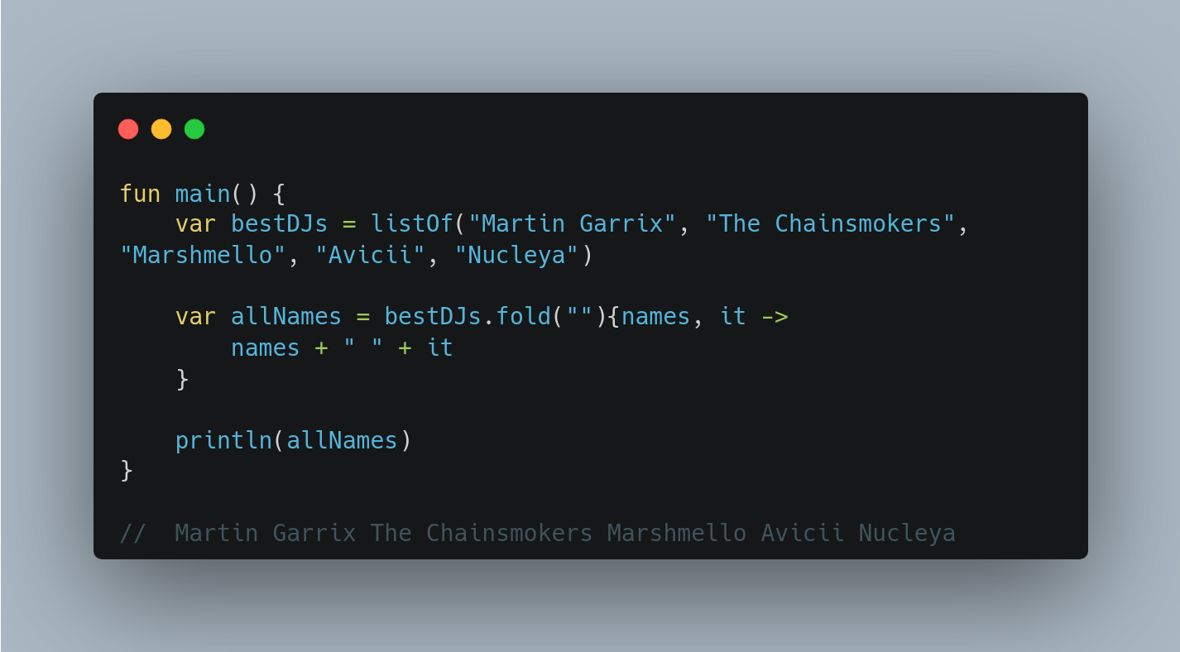
fold()
The fold() function is used to generate a single value from a collection. This is most commonly used for things like calculating a total of prices, or summing all the elements in a list to find an average.

Slide 66
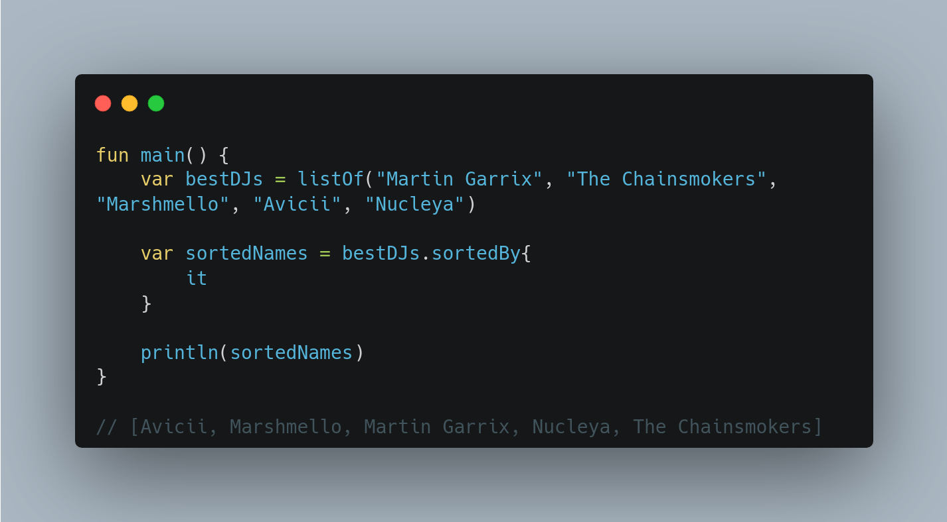
sortedBy()
Kotlin collections provide a sortedBy() function. sortedBy() lets you specify a lambda that returns the property you'd like to sort by.

